Slide 1
Killing Your Inner Techbro
IGNITE LONDON Dan Sparks
Oct 31st 2018 @DanRoeSparks

Slide 2
DIVERSITY is GOOD
SMARTER
PERFORMANCE
OUTCOMES

Slide 3
EVIDENCE: ACCELERATE
itrevolution.com

Slide 4
EVIDENCE: PROGRAMMED INEQUALITY
The MIT Press

Slide 5
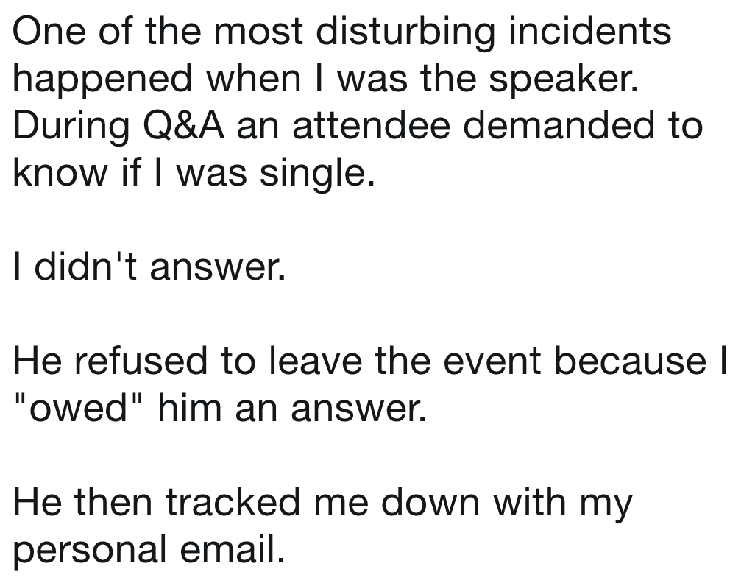
EVIDENCE: THE WORLD

Slide 6
STOP HURTING YOURSELF
marriedtothesea.com

Slide 7
CALL IT OUT

Slide 8
INTENT IS NOT ACTION

Slide 9
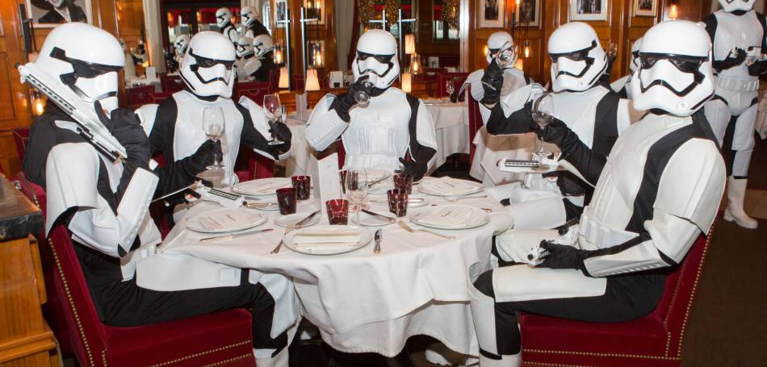
BestImage

Slide 10
DON’T PERFORM

Slide 11
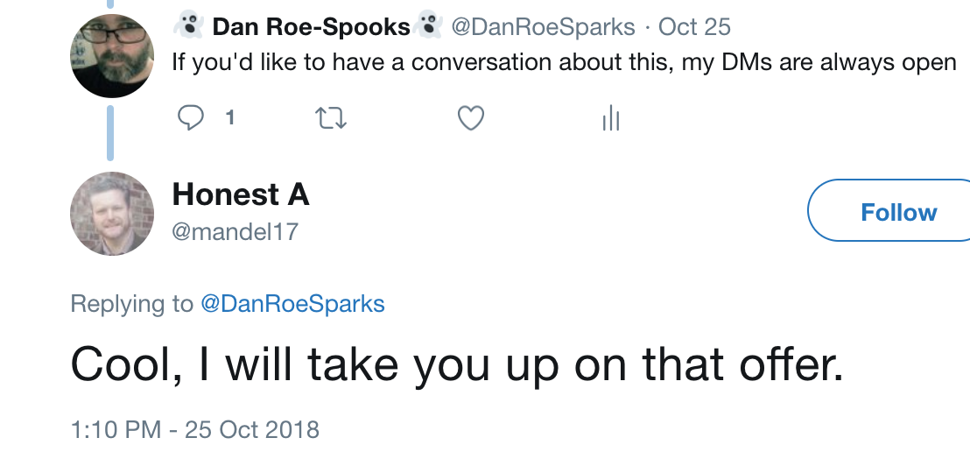
Reach out
A. Pseudonym

Slide 12
DON’T get mad, be even

Slide 13
Apply sparingly

Slide 14
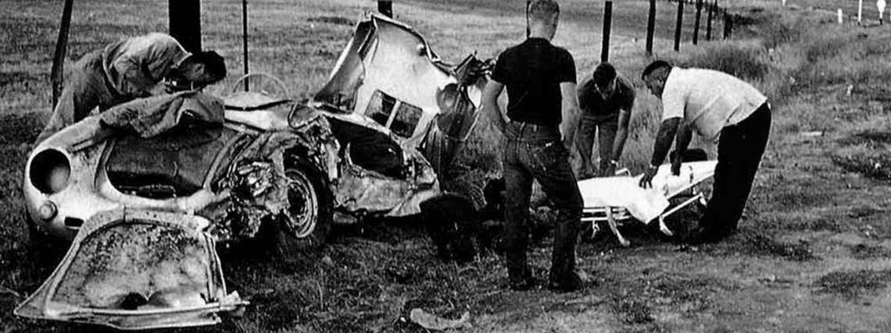
#notallmen
Seita Ohnishi

Slide 15
FEEDBACK is GOOD
LISTEN
PLAN
IMPLEMENT

Slide 16
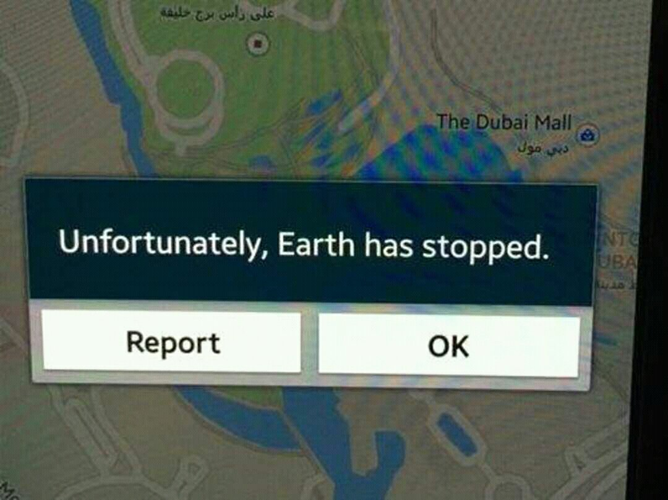
FAILURE IS AN OPTION

Slide 17
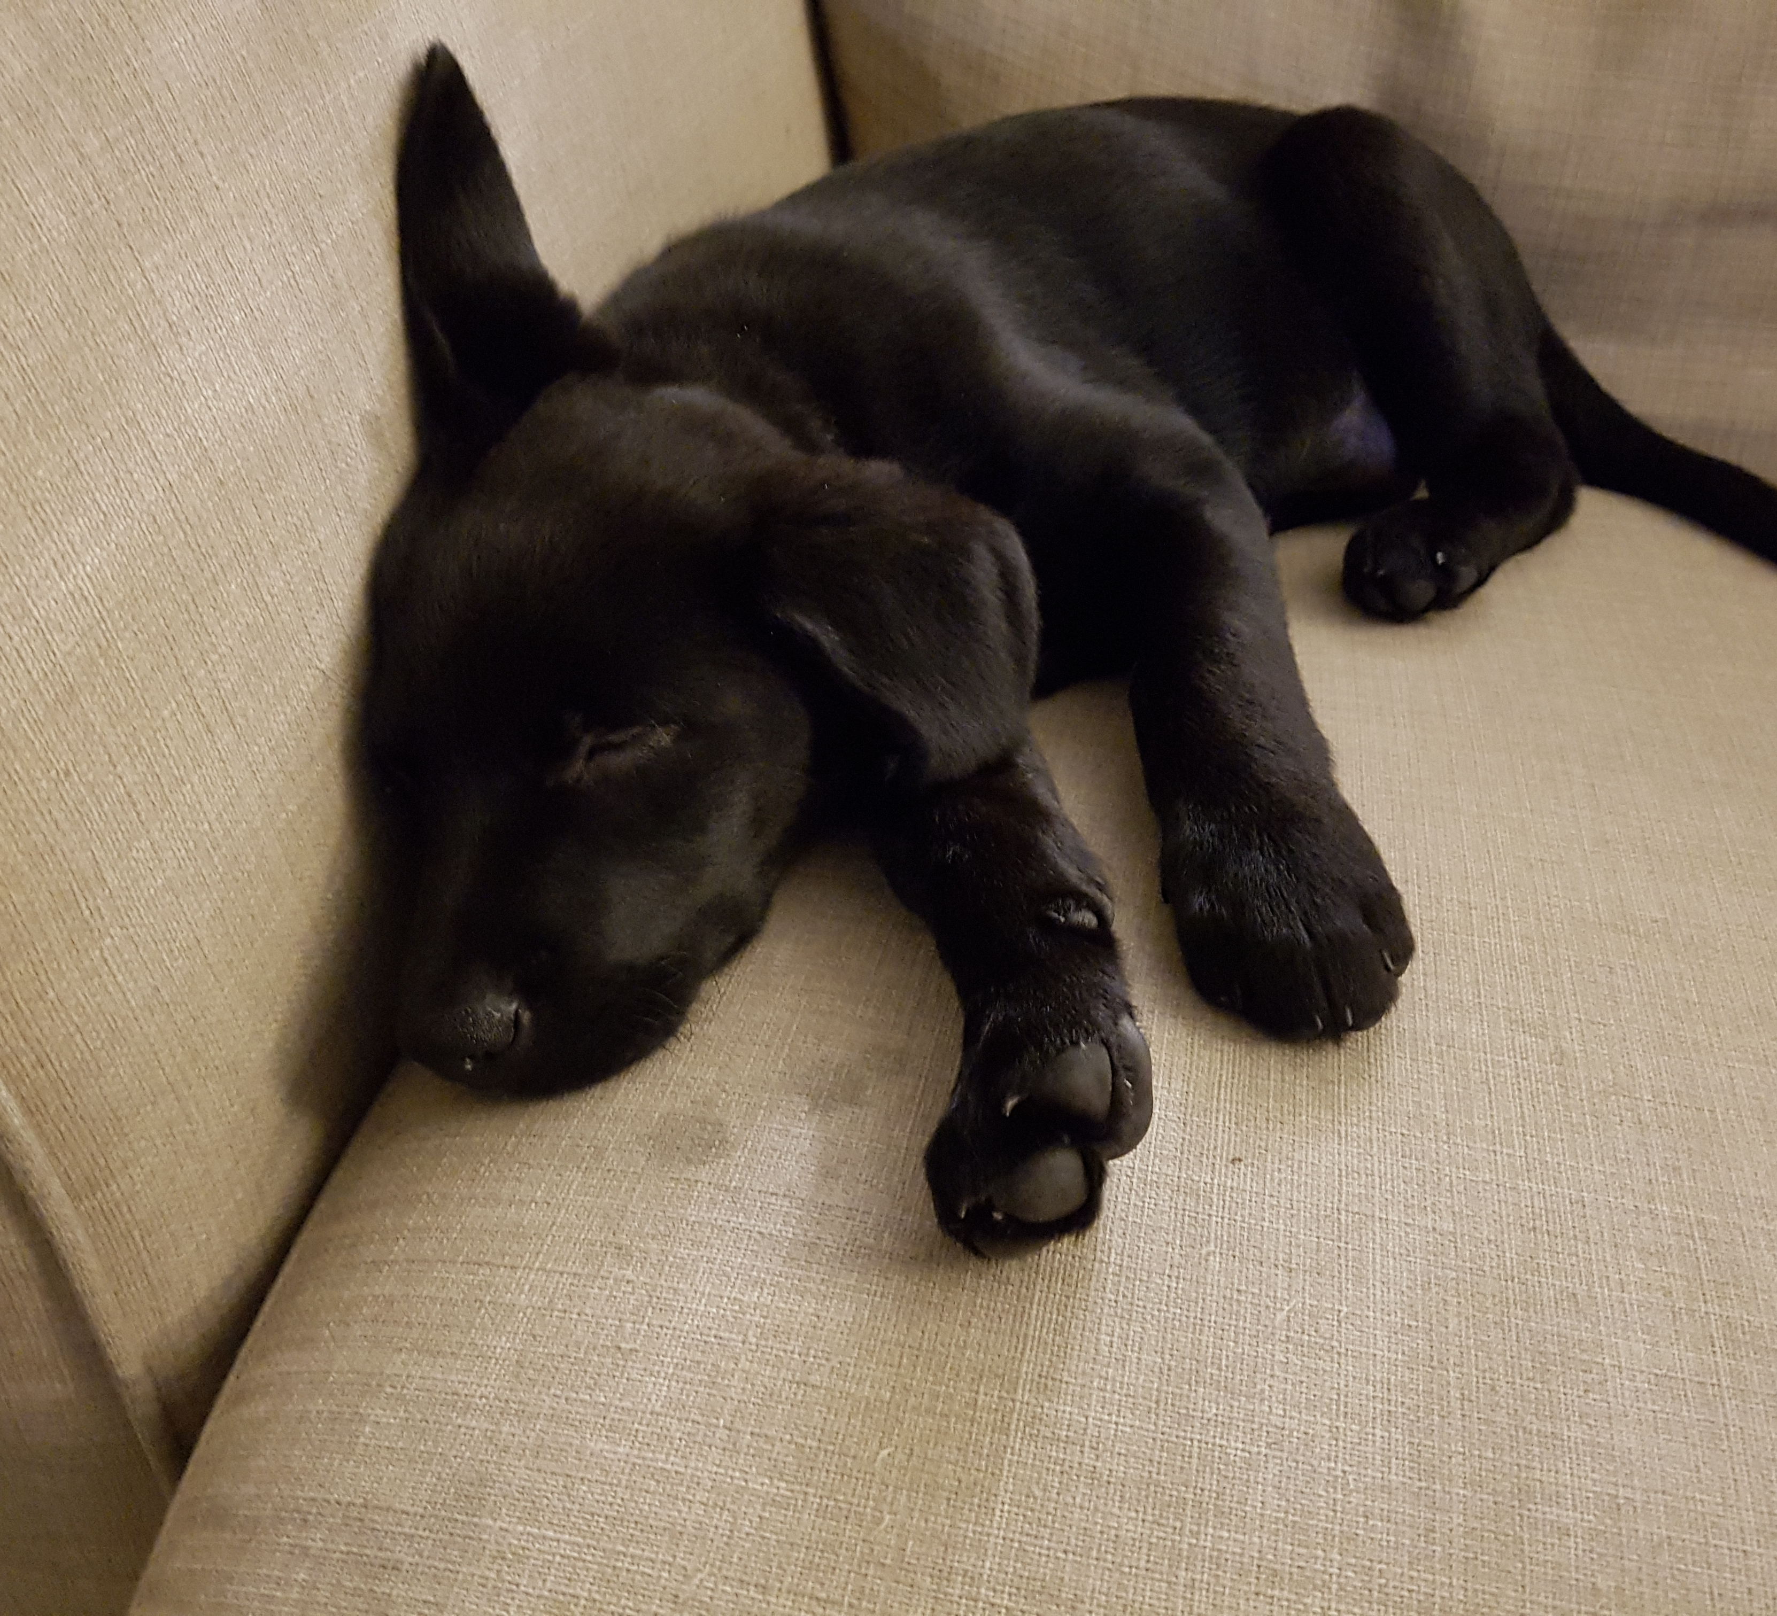
DON’T BURN OUT
Yes, it’s my dog

Slide 18
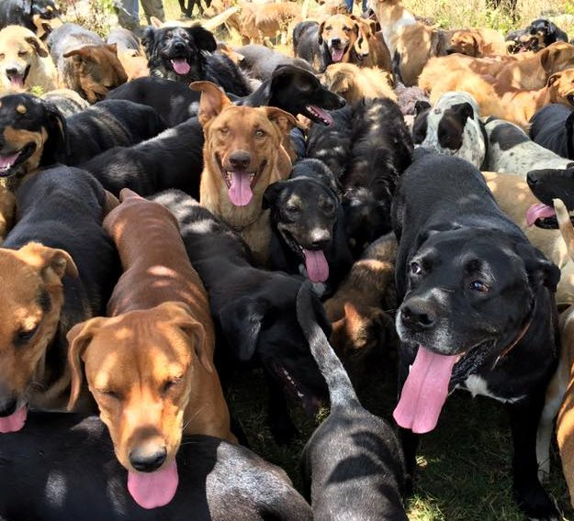
Who’s got your back?
Territorio de Zaguates

Slide 19
JOIN ME ON SLACK
****

Slide 20
LET’S FIX THIS

